Slide 1
Cross Validation in Machine Learning
-Prof. Rushikesh Dhande

Slide 2
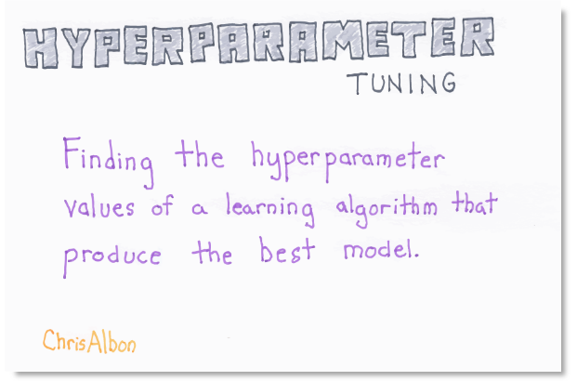

Slide 3
Cross-validation
Cross-validation is a technique in which we train our model using the subset of the data-set and then evaluate using the complementary subset of the data-set.
we perform training on the 70% of the given data-set and rest 30% is used for the testing purpose.
The major drawback of this method is that we perform training on the 70% of the dataset, it may possible that the remaining 30% of the data contains some important information which we are leaving while training our model

Slide 4
Types of Cross Validation in Machine Learning
LOOCV (Leave One Out Cross Validation)
In this method, we perform training on the whole data-set but leaves only one data-point of the available data-set and then iterates for each data-point
Disadvantage : Outlier, Slow,Traditional.

Slide 5
K-Fold Cross Validation
we split the data-set into k number of subsets(known as folds) then we perform training on the all the subsets but leave one(k-1) subset for the evaluation of the trained model.
It is always suggested that the value of k should be 10 as the lower value of k is takes towards validation and higher value of k leads to LOOCV method.

Slide 6
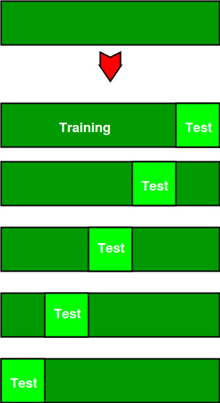
How K-Fold works

Slide 7
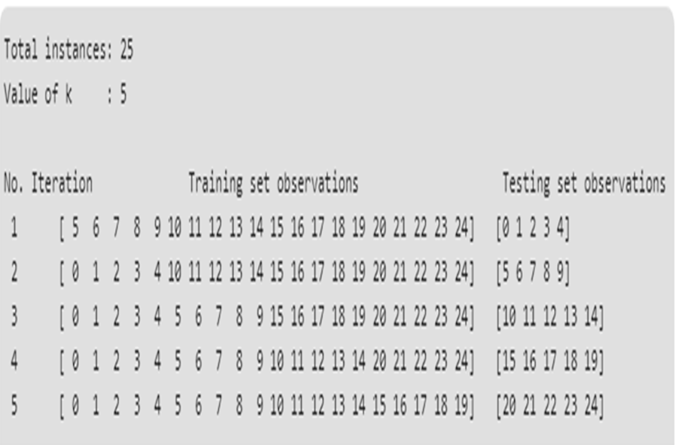

Slide 8
GridSearchCV
Grid search is an approach to parameter tuning that will methodically build and evaluate a model for each combination of algorithm parameters specified in a grid.
You can just cross validate your model using k-fold or if you use another technique for validation you can just use grid search to find the optimum parameters for your model

Slide 9
Syntax
G_model = GridSearchCV(estimator, param_grid, scoring, cv)
Where estimator is your model and parameters are options you want to set for your grid search. Including options like param_grid, this is a dictionary of parameters you want to run your search for, etc.

Slide 10
https://www.ritchieng.com/machine-learning-efficiently-search-tuning-param/
https://machinelearningmastery.com/k-fold-cross-validation/

